Slide 1
OPTIMIZING CRISPR GENOME EDITING WITH MACHINE LEARNING
RILEY DOYLE, CEO AND TECHNICAL LEAD
MAY 2016
Notes:
- We’re an Illumina-backed software company focused on helping you manipulate genomes

Slide 2

DESKTOP GENETICS
HELPING YOU MANIPULATE GENOMES
WWW.DESKGEN.COM
Notes:
We’re a software company based in London and Boston
We help researchers manipulate genomes
You may be familiar with our public Deskgen software, used by 2000 users thousands of guides
We also provide a range of genomic services built with an advance internal version of our platform
We work with a number of organisations, some of whom are here today

Slide 3
DECLARATION OF CONFLICT OF INTERESTS
TYPE | COMPANY
Employment full time | Desktop Genetics
Ownership interest | Desktop Genetics
Notes:
NAG guides included (negative control)
Several negative predictors ( aka bad guides) were evaluated
Positive control was guides from other libraries

Slide 4

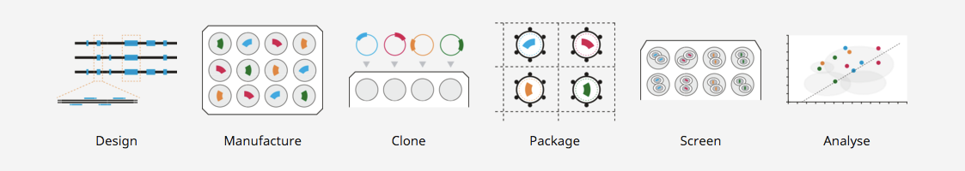





COMPLEX, BUT NOT COMPLICATED
VARIANT TO FUNCTIONAL VERIFICATION IN WEEKS

Slide 5
AGENDA
Brief intro to CRISPR and machine learning
Evaluation of design rules & scoring functions
Guide RNA design tips

Slide 6
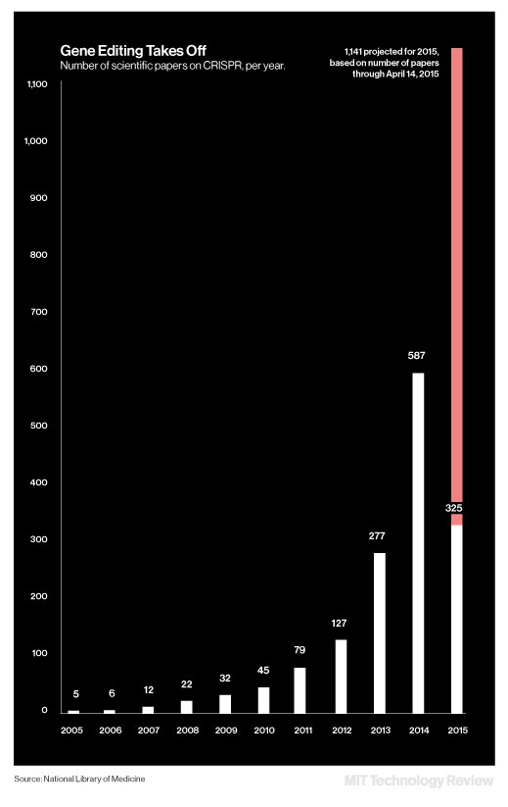


CRISPR/CAS9
FAST, CHEAP, AND ROBUST EDITING IN MANY SPECIES
GENOME EDITING TAKES OFF
2015 | 2020 E
20,000 - 40,000 labs | 30,000 - 66,000 labs
250,000 - 600,000 experiments | 376,000 - 3,400,000 experiments
[SOURCE: TRIANGULATED FROM DTG, HZD, ADDGENE + ASSUMPTIONS]
Notes:
Genome Editing, particularly CRISPR/Cas9, is growing explosively.
Genome editing: changing the DNA in cells in a targeted way, such as through a computer designed RNA-guided Nuclease
Over 43,000 labs are doing it
Specialist software is essential to handle data volume and complexity
It represents an enormous growth area in bio-tools

Slide 7


CRISPR OVERVIEW
PROGRAMMABLE TWO COMPONENT SYSTEM
CAS9
NUCLEASE
VARIALBE
20 BP GUIDE RNA
(sgRNA)
CONSTANT
REGION
(tracrRNA)
RNA
COMPONENT

Slide 8

CRISPR OVERVIEW
PROGRAMMABLE TWO COMPONENT SYSTEM
CAS9
NUCLEASE
ACTIVE
RNA-GUIDED CAS9
COMPLEX
RNA
COMPONENT

Slide 9
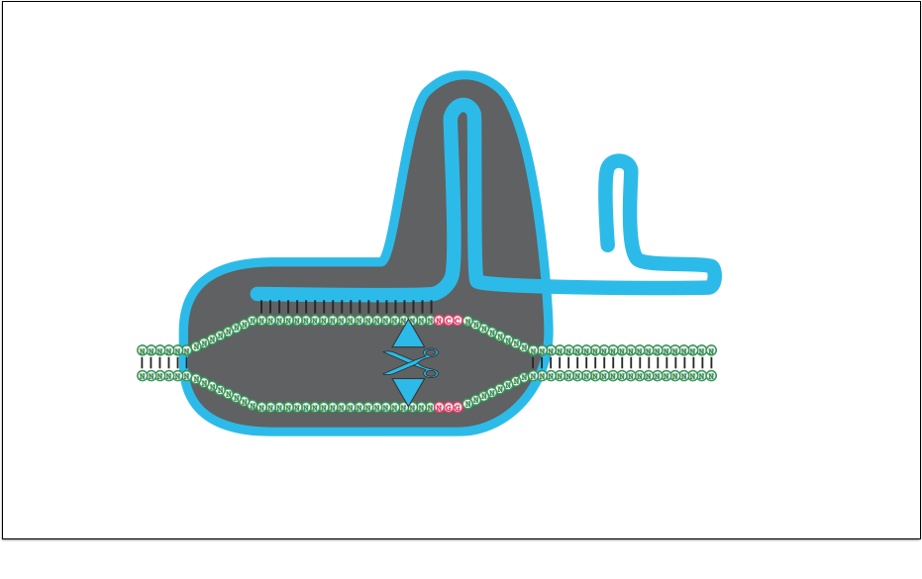
CRISPR OVERVIEW
CUT + REPAIR = GENOME EDITING
sgRNA-DNA
BASE PAIRING
GENOME
SEQUENCE
NUCLEASE DOMAINS
NGG PAM SEQUENCE

Slide 10
RECURRING CRISPR MISTAKES
USER ANALYTICS REVEALED COMMON PROBLEMS
 | HUMAN | MACHINE
Guide selection | Bias toward 5’ sense strand guides | Considers all guides, choses consistently
Scoring function(s) | Undue weight given to some scoring functions | Weights of up-to-date scoring functions carefully controlled
Genotype data | Considers reference genome or sanger sequence | Considers actual genotype of cell line
Overall objective | Few “winning” guides | Balanced, orthogonal guide set
CRISPR
Notes:
Reduce wordiness

Slide 11
STATISTICAL LEARNING
BIOLOGICAL ML HAS DISTINCT CHALLENGES
STAGE | CAT DETECTION | CRISPR GENOME EDITING
Data Set | 1E5 instances photos downloaded in hours | 380 million guides per genome
Measurement | Digital data ready for analysis | Develop assay to screen 1E4-1E9 guides 3-10x
Features | Resolution of image (finite) | Unknown (likely 1E4)
Modeling | Trial many models in parallel | Trial many models in parallel
Evaluation | Try model on new photos | Trial untested guides in lab
Generalizability | Repeat for other things | Unknown

Slide 12
SUMMARY OF APPROACH
BIOLOGICAL ML HAS DISTINCT CHALLENGES
STAGE | Our Approach
Feature Set | 15 Popular scoring functions and design rules from the literature
Training Set | Custom library targeting suspected essential genes designed to maximize feature extraction
Read Out | Cell survival as read by NGS of guide barcode
Modeling | Validate features individually then combine with various models
Evaluation | Try model new gene targets

Slide 13
DESIGNING BAD GUIDES
LIBRARY MUST BALANCE GENERALIZABILITY AND VARIANCE
Orthogonal guides are distinct, not correlated, and span a range of property values.
This makes the data generalizable!
Replicate guides have the same or similar property values so variance can be averaged out.
“Good” Guides
Actual Activity
Line cleanly divides groups
“Bad” Guides
Effect
Predictor (Score)
Notes:
Discuss the design rules
Sent for sythensis, screening, and NGS analysis.
Make into 3 slides --- what is the goal of the library, positive predictors, negative predictors

Slide 14
BUILDING A TRAINING DATA SET
EVALUATING NEGATIVE PREDICTORS (FEATURES)
DESIGN RULE | TYPE | RANGE | CONSIDERS
NAG PAM (Control) | Negative | {0,1} | (PAM) Sequence
GC% | Negative | [0,1] | Sequence
Homopolymer (N4) | Negative | {0,1} | Sequence
SNP Collision | Negative | {0,1} | Location
UUU Triplet | Negative | {0,1} | Sequence
Non-constitutive Transcript | Negative | {0,1} | Location
Notes:
NAG guides included (negative control)
Several negative predictors ( aka bad guides) were evaluated
Positive control was guides from other libraries

Slide 15
BUILDING A TRAINING DATA SET
EVALUATING POSITIVE PREDICTORS (FEATURES)
DESIGN RULE | TYPE | RANGE | CONSIDERS
Target gene essential | Positive | {0,1} | Location
Chari et al. 2015 | Positive | [0,1] | Sequence
Doench et al. 2014 | Positive | [0,1] | Sequence
Doench et al. 2016 | Positive | [0,1] | Sequence
Hsu et al. 2013 | Positive | [0,1] | (Genome) sequence
1st third CDS | Positive | {0,1} | Location
Functional domain | Positive | {0,1} | Location
Truncated guide | Positive | {0,1} | Sequence
Microhomology | Positive | [0,1] | Sequence
Notes:
Positive predictors say if the guide is “good”
3 popular scoring functions included

Slide 16
EXPERIMENT OVERVIEW
SUSPECTED ESSENTIAL GENE LIBRARY SCREENING
AIM | Target essential and neutral genes for knock-out
EXPERIMENTAL PARAMETERS | Cell line: A375 melanoma Number of essential targets: 100 genes, 3000 sgRNAs Number of neutral targets: 745 genes, 7500 sgRNAs Controls: Neutral gene dataset & NAG non-canonical PAM- targeting dataset Readout: Depletion of Next Generation Sequencing (NGS) reads from KO-induced cell death Study modeled after Shalem et al. (2014) depletion library Blind study analysis independent of bench work
COLLABORATOR | ERIC RHODES JON MOORE BENEDICT CROSS

Slide 17
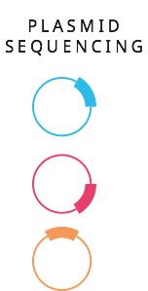
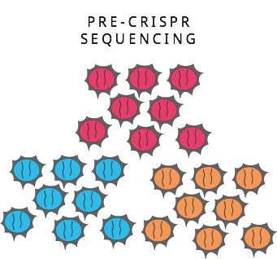
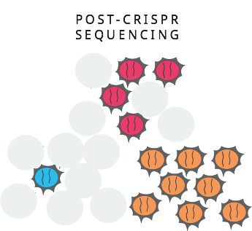
ASSAY OVERVIEW
THOUSANDS OF GENES TESTED IN PARALLEL
2x
OLIGO
SYNTHESIS
PLASMID CLONING
DRUG
SELECTION
Day -4
‘Day 0’ START
Day 12
Day 24
VIRAL
PACKAGING
3 days
4 days
12 days
12 days
INFECT CELLS
NGS 1
NGS 2
NGS 3
NGS 4
NGS 5
READ DEPLETION
represents sgRNA efficacy

Slide 18
RESULTS

Slide 19
EXAMPLE DISTRIBUTION
HIGH VARIANCE OBSERVED WITH SHIFTS IN MEDIAN
Notes:
- Mann-Whitney U test (ordinal data based on rank)

Slide 20
NEGATIVE PREDICTORS WORK
EFFECTIVELY ELIMINATE BAD GUIDES (NO WASTE)
DESIGN RULE | TYPE | RANGE | CONSIDERS | RESULT
NAG PAM (Control) | Negative | {0,1} | (PAM) Sequence | ✔
GC% | Negative | [0,1] | Sequence | ✔
Homopolymer (N4) | Negative | {0,1} | Sequence | ✔
SNP Collision | Negative | {0,1} | Location | ✔
UUU Triplet | Negative | {0,1} | Sequence | ✔
Non-constitutive Transcript | Negative | {0,1} | Location | ✔
Notes:
NAG guides included (negative control)
Several negative predictors ( aka bad guides) were evaluated
Positive control was guides from other libraries

Slide 21
POSITIVE PREDICTORS COMPLEX
POSITIVE PREDICTORS TEND TO IMPROVE THE ENSEMBLE
DESIGN RULE | TYPE | RANGE | CONSIDERS | RESULT
Target gene essential | Positive | {0,1} | Location | ?
Chari et al. 2015 | Positive | [0,1] | Sequence | ✔
Doench et al. 2014 | Positive | [0,1] | Sequence | ✔
Doench et al. 2016 | Positive | [0,1] | Sequence | ✔
Hsu et al. 2013 | Positive | [0,1] | (Genome) sequence | ?
1st third CDS | Positive | {0,1} | Location | ✖
Functional domain | Positive | {0,1} | Location | ?
Truncated guide | Positive | {0,1} | Sequence | ✖
Microhomology | Positive | [0,1] | Sequence | ✖
Notes:
Positive predictors say if the guide is “good”
3 popular scoring functions included

Slide 22
COMBINING PREDICTORS
COMBINATIONS OF PREDICTORS MOST EFFECTIVE
Notes:
16% winners, 15% losers, the rest are moderately active
Interpretation of those in between is trickier,

Slide 23
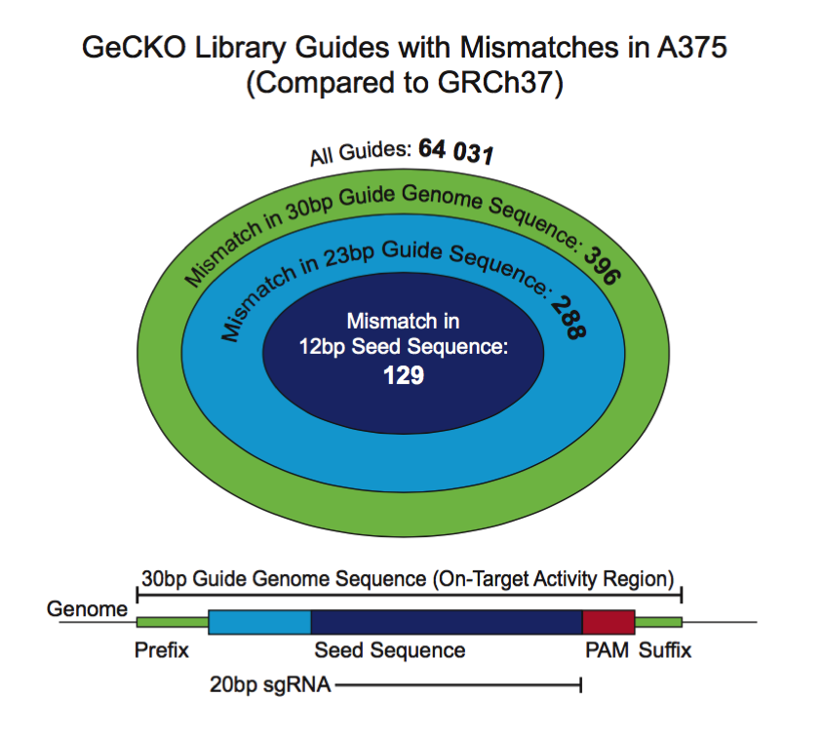
CONSIDER ACTUAL GENOTYPE
USE NGS DATA TO ACCOUNT FOR GENOMIC VARIATIONS
Both SNPs and CNVs are present in real world cell lines and have an effect the apparent depletion level of the guide.

Slide 24
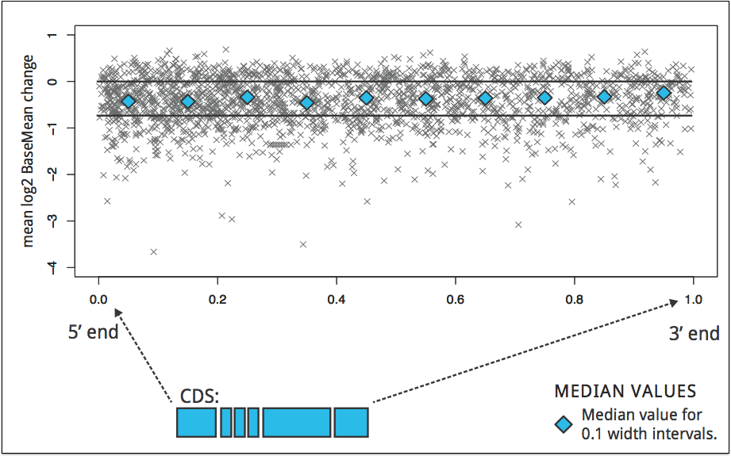
TARGET ENVIRONMENT
5’ TARGETING PROVIDES NEGLIGIBLE CHANGE IN EFFICACY

Slide 25
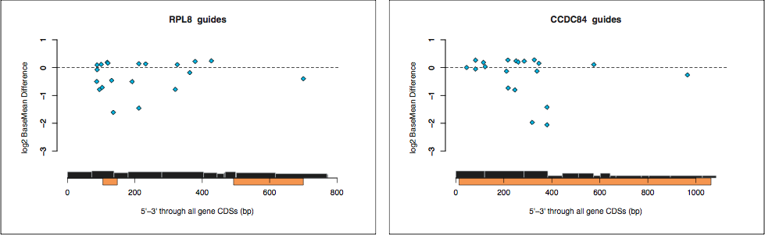
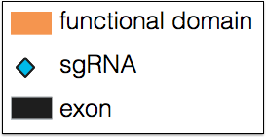
TARGET ENVIRONMENT
FUNCTIONAL DOMAINS MUST BE EVALUATED CAREFULLY
Functional domains vary in size and the key amino acids are often dotted within them.
The benefit of functional domain targeting may need to be assessed on a gene by gene basis

Slide 26
HUMANS VS. MACHINES
SOFTWARE-DESIGNED LIBRARIES OUTPERFORM MANUAL DESIGNS
 | Fraction of guides exhibiting >2x depletion
Example Gene | Manual | Automated (GeckoV2) | SVM (Wang) | Our work (DESKGEN)
PCNA | 1/5 | 2/6 | 5/9 | 5/5
PSMA7 | 1/5 | 0/6 | 2/9 | 3/5
RPP21 | 3/5 | 1/6 | 4/9 | 2/5
SF3B3 | 0/5 | 0/6 | 4/9 | 3/5
Average (%) | 25% | 12.5% | 42% | 65%
 | MANUAL | AUTOMATED | SVM | DESKGEN

Slide 27
FUTURE WORK
FURTHER IMPROVEMENT VERY LIKELY
Reproduce predictions with orthogonal assay (T7E1, FACS)
Further optimization of statistical model
Develop normalization method (ranking) to compare across experiments
GuideDB will be made available to the community later this year
Notes:
Standardize and submit to GuideDB (API is incidental).

Slide 28

ACKNOWLEDGEMENTS
THE DESKTOP GENETICS TEAM
Desktop Genetics
Leigh Brody, Director of Genomic Services
Neil Humphryes-Kirilov, Senior Bioinformatician
Victor Dillard, Chief Operating Officer and Founder (Executive Sponsor)
Collaborators
Benedict Cross, Team Leader, Discovery Screening, Horizon Discovery
Jacob Corn, Scientific Director, Berkeley IGI (Scoring function discussion)
Julian Cornibese, Sr. Research Scientist Google Deepmind (Machine learning discussion)

Slide 29
HTTPS://WWW.DESKGEN.COM
rileyd@DESKGEN.COM
Jobs: getin@deskgen.com
Notes:
Change the logo

Slide 30
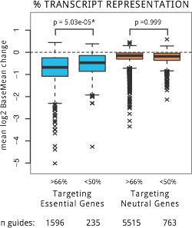
NEGATIVE PREDICTORS
WHICH GUIDES WON’T WORK APPEARS EASIER QUESTION
Notes:
Space these one plot per slide Do a summary
Start with Uracil or transcript representation big to give an orientation to the plots
Then run through the rest

Slide 31
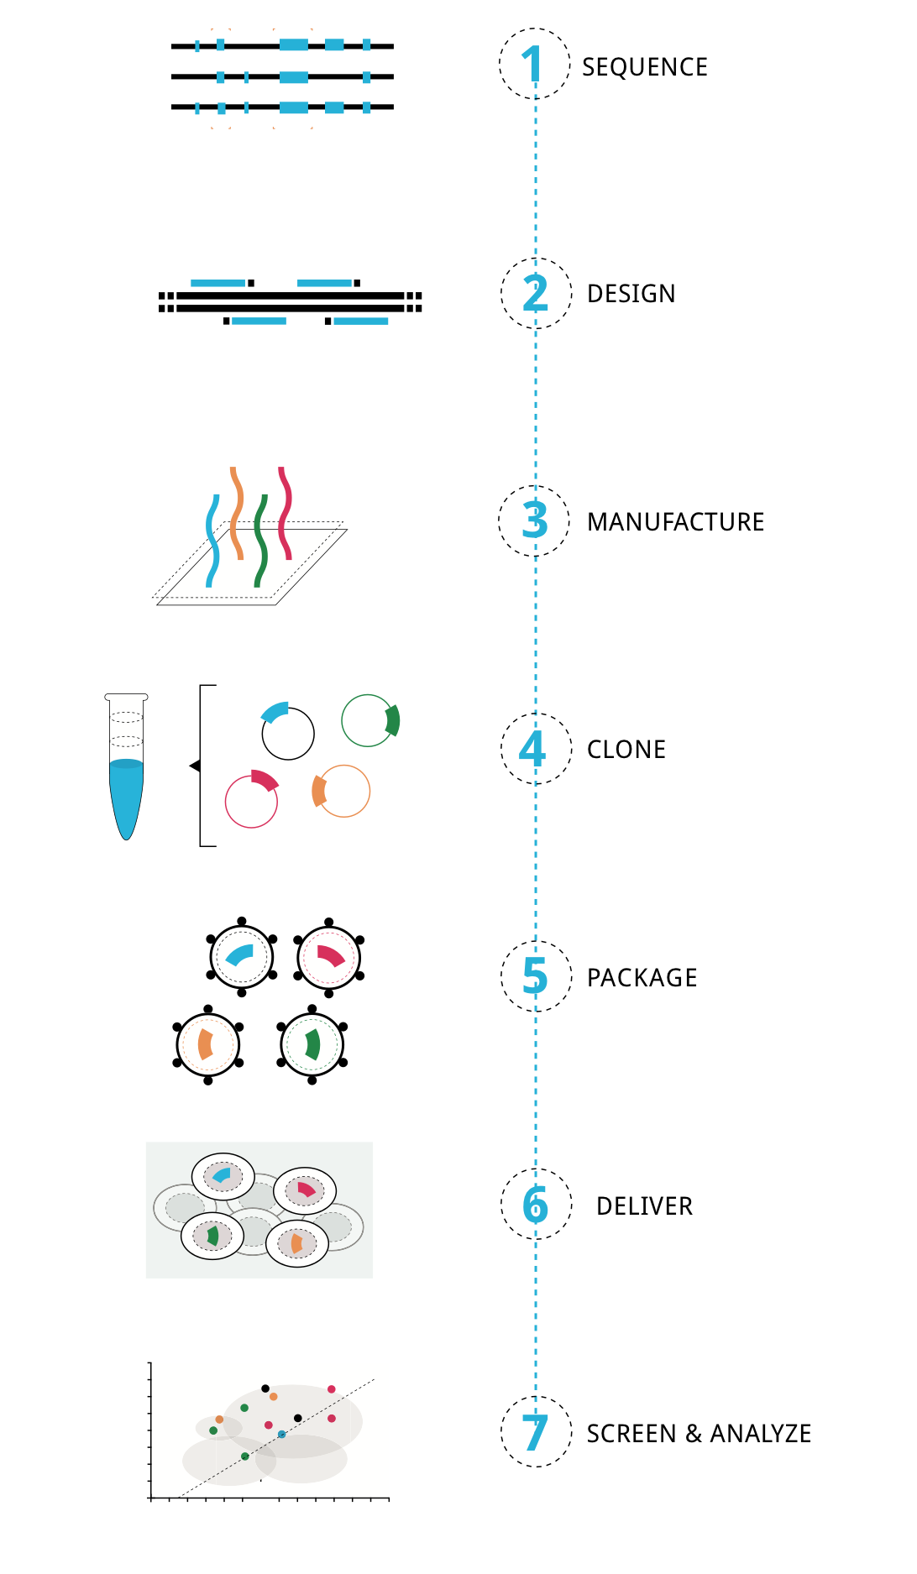


COLLABORATION
WORK WITH DESKTOP GENETICS AND OTHER SPECIALISTS
Notes:
Proud to work with a great network of partners, including twist
Come see me for more details
In and out at any point in the process

Slide 32
GENOTYPE AND OFF-TARGETS
SNPs MODULATE APPARENT GENOTOXICITY
Many DS Breaks
Cell Death
Depletion & “Activity”
Notes:
Guides with low off target scores were more “active” in this assay
Score Sensitive to SNPs, Indels, CNVs considered
Trend holds across all populations suggesting it’s a general effect
Source of false positives

Slide 33
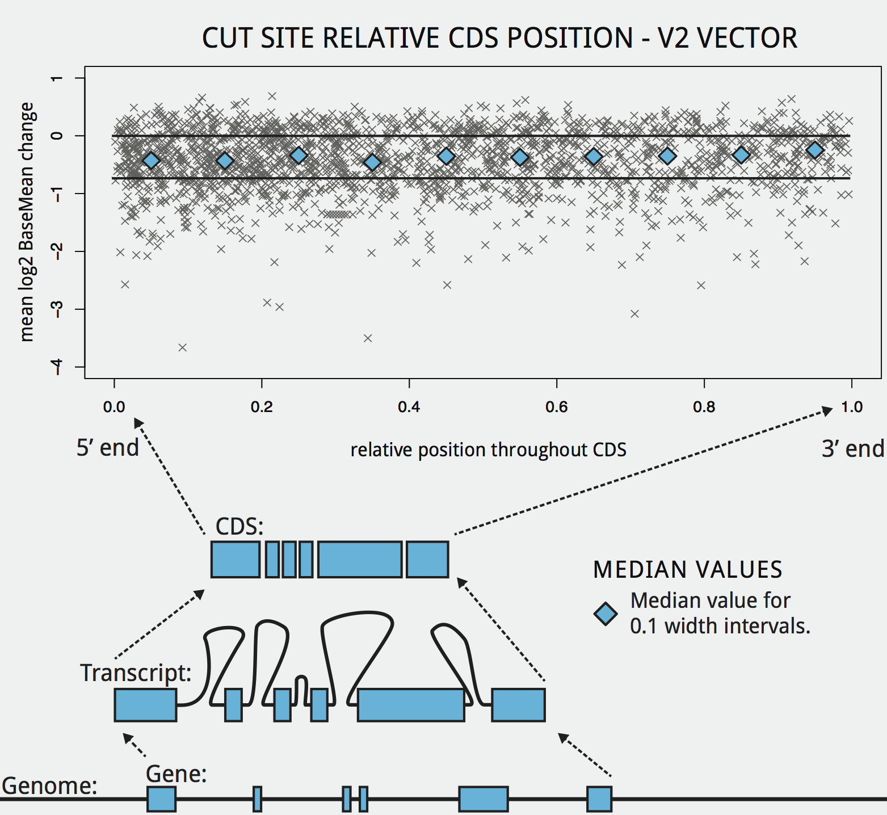
POSITIVE PREDICTORS
ENRICHMENT FOR ACTIVE GUIDES AT LIBRARY LEVEL
Notes:
Doench and Chari both enriched for active guides (but don’t guarantee success)
Cutting in a functional domain had more mixed results (not all functional domains are equal, some span entire cds, so are active site)
Position of cut site doesn’t really matter much, 1st 3rd rule isn’t so important

Slide 34
COMBINING PREDICTORS
COMBINATIONS OF PREDICTORS PERFORMED BEST
Manual design success rate ~36% per guide vs. Machine at 85%
Notes:
16% winners, 15% losers, the rest are moderately active
Interpretation of those in between is trickier,

Slide 35
HUMANS VS. MACHINES
SEVERAL MACHINE APPROACHES OUTPERFORMED MANUAL DESIGN
 | Fraction of guides exhibiting >2x depletion
Essential Gene | Manual | Automated (GeckoV2) | SVM (Wang) | Our work
PCNA | 1/5 | 2/6 | 5/9 | 5/5
PSMA7 | 1/5 | 0/6 | 2/9 | 3/5
RPP21 | 3/5 | 1/6 | 4/9 | 2/5
SF3B3 | 0/5 | 0/6 | 4/9 | 3/5
Average (%) | 25% | 12.5% | 42% | 65%
Notes:
Control set of essential genes
2x depletion as significant
Both machine learning approaches beat two different human designed library
Our combination approach is most effective on this set

Slide 36
SOURCES OF VARIANCE
EXTERNAL VARIANCE COMPLICATES ANALYSIS
Variance
Vector
Promoter
Nuclease
Cell Line
Genotype
DNA Repair Pathways
Tracr
Restriction Factors
Protocol
Time Points
Read Counting
Gene
“Essentiality”
Copy Number
Leaky
Constitutive
Notes:
Talk only to the second level, touch on vector

Slide 37
GUIDE RNA FEATURES
SEQUENCE APPROACH PLAGUED BY CURSE OF DIMENSIONALITY
Number of non-overlapping, position-dependent sequence features is:
where k = feature size (nt) and n is length of sequence
Doench (2014) uses single and pairs yielding 316 features (dimensions).
Too many dimensions + insufficient data = over fitting
Notes:
Add more here?
Assume no knowledge here
Split into two slides
Talk about dimensionality, Problem
Then talk about solution

Slide 38

GUIDE RNA FEATURES
DESIGN RULES EFFICIENTLY TURN SEQUENCES TO A LIST OF NUMBERS
Palindrome
0 or 1
GC content
%
ΔΔG
EcoRI
Asking a series of questions about the guide and
recording answers in a list is better:
Now feed this 3D vector into classifier code
Regression models should be used for guide activity
Notes:
Add more here?
Assume no knowledge here
Split into two slides
Talk about dimensionality, Problem
Then talk about solution

Slide 39
DTG’S INTERNAL PLATFORM
ENABLE PARALLEL EVALUATION OF MULTIPLE STATS. MODELS
Published &
novel ‘omics
data
Designs to fab
Annotation
Design
GenomeDB
Published
Guides & NGS
data
Regressions
Scoring
Analysis
GuideDB
INPUTS/OUTPUTS
ALGOS & PIPELINES
DATABASE
ALL MODELS CAN ACCESS COMMON STRUCTURED, INDEXED, NORMALIZED GUIDE RNA
AND CELL LINE SPECIFIC GENOME DATA WHILE BEING EVALUATED IN PARALLEL

